Slide 1
Pipelining 2
Dr. John P. Abraham
Professor
UTRGV

Slide 2
Credit
Most slides are from Hennessy and Patterson
Some material is credited to Dr. Padraic Edington of University of Connecticut

Slide 3
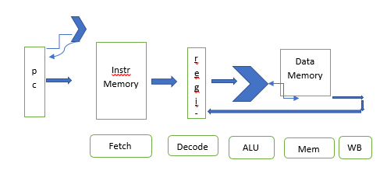
In an unpipelined CPU
1Program counter gives the instruction address to execute. 2Fetch it from the InstructionMemory 3Decode the Instruction. 4Based on the instruction ALU will perform execution if the values are in the registers. 5If not, the ALU will have calculated data memory address, fetch the data and load into registers. 6Result is written back to a register.
Decode doesn’t take much time. Decode and filling the registers and writeback can be done within one clock cycle (write then read from the registers). Each stage is given one clock cycle. In unpipelined, each component keeps its contents until instruction is completed.
When pipelining, the stages can overlap execute instructions in parallel. For this, intermediate buffers need to added, IF/ID, ID/EX, EX/MEM and MEM/WB (since one stage does not hand the result to the next stage). Read or Write to a register only takes ½ cycle.

Slide 4
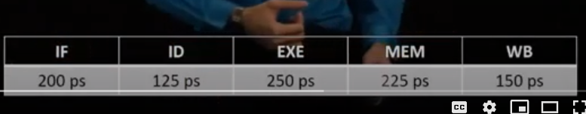
Clock cycle
A clock cycle should accommodate the longest stage The latency of an instruction is time it takes for one stage times (x) the number of stages (5). Every instruction must pass through all the stages. If MEM stage takes the most time (say 250 picoseconds), and other stages less than that, the clock cycle time should be adjusted to 250 ps. The latency then is 250x5=1250 ps.

Slide 5
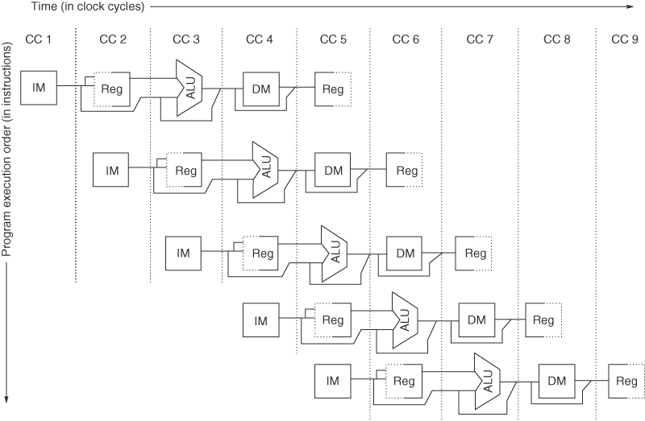
The pipeline can be thought of as a series of data paths shifted in time.
Figure C.2 This shows the overlap among the parts of the data path, with clock cycle 5 (CC 5) showing the steady-state situation. Because the register file is used as a source in the ID stage and as a destination in the WB stage, it appears twice. We show that it is read in one part of the stage and written in another by using a solid line, on the right or left, respectively, and a dashed line on the other side. The abbreviation IM is used for instruction memory, DM for data memory, and CC for clock cycle.

Slide 6
Buffers between stages (like a bin a pipeline worker might place the product)
It is mandatory that there exist distinct memory units (caches) for data (DM) and instructions (IM); this prevents conflicts between IF and MEM phases. Both phases access memory, that is used 5 times more than with no pipelining. The memory subsystem must be capable of handling the increased workload.
Buffers need to be added between stages. Shown as gray bars in the next diagram.
Since the cpu is working different instructions, cpu can’t hand over the results directly to the next stage, it is placed in the buffer and the next stage will get it from the buffer.

Slide 7
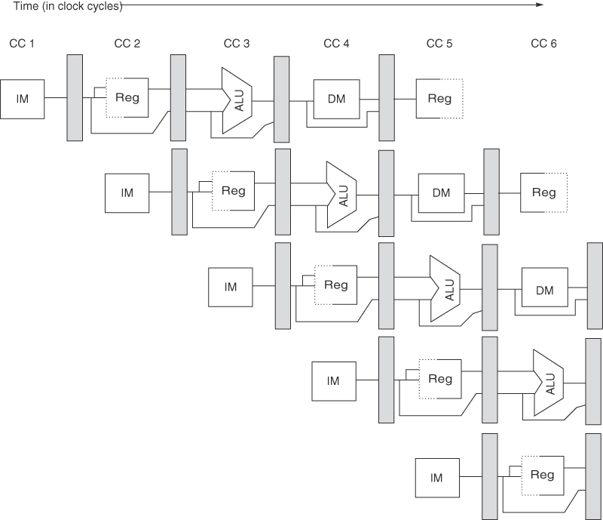
Figure C.3 A pipeline showing the pipeline registers between successive pipeline stages. Notice that the registers prevent interference between two different instructions in adjacent stages in the pipeline. The registers also play the critical role of carrying data for a given instruction from one stage to the other. The edge-triggered property of registers—that is, that the values change instantaneously on a clock edge—is critical. Otherwise, the data from one instruction could interfere with the execution of another!

Slide 8
Figure C.3 A pipeline showing the pipeline registers between successive pipeline stages. Notice that the registers prevent interference between two different instructions in adjacent stages in the pipeline. The registers also play the critical role of carrying data for a given instruction from one stage to the other. The edge-triggered property of registers—that is, that the values change instantaneously on a clock edge—is critical. Otherwise, the data from one instruction could interfere with the execution of another!

Slide 9
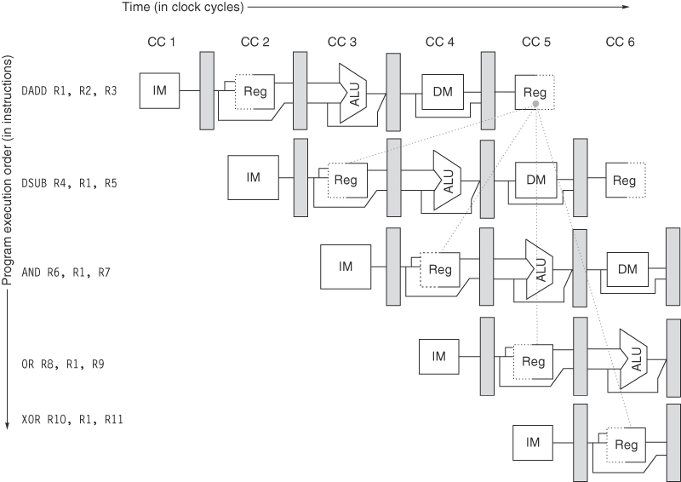
Figure C.6 The use of the result of the DADD instruction in the next three instructions causes a hazard, since the register is not written until after those instructions read it.

Slide 10
Pipeline Hazards (Hurdles)
Structural Hazard – hardware can’t support all requests simultaneously. (Lack of resources)
Data hazard – data depends on a previous instruction execution
Control hazard – Program counter gets a different value because of branches. The next instruction fetched is unusable now.

Slide 11
Hazards
Hazards are three types:
Structural: Attempt to use the same resource by diff instrucctions. MIPS designed to avoid hardware contention (separate Instruction Memory). Two instructions may want to use the same register or another hardware. MIPs allows only one instruction in the process to access a hardware. In the case of a register where we write and read within one clock cycle, we can write in first half and read in second half or vice-a-versa). Also split mem to instr and data memories. This will avoid structural hazards.
Data If input depends on output of another
Control In case of branches how do we fetch next instruction? What happens to instructions already in the pipeline?

Slide 12
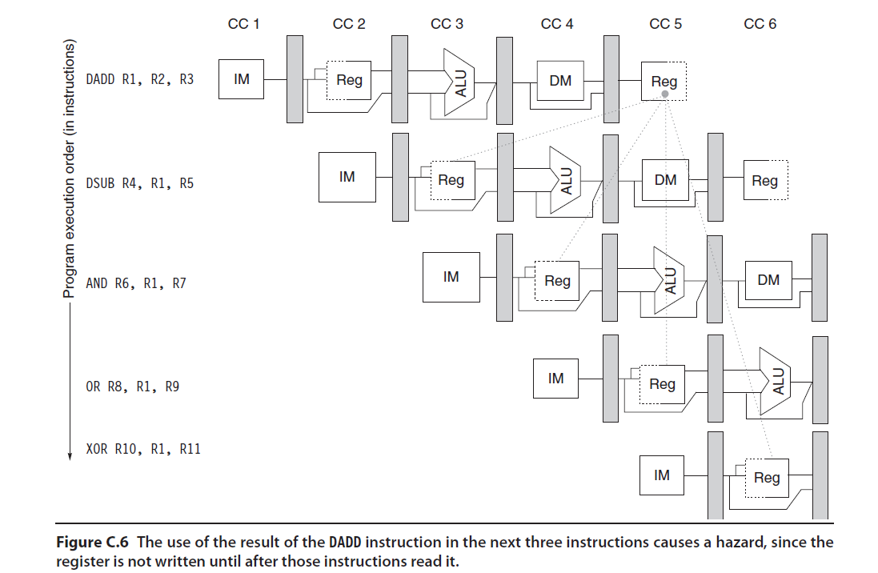

Slide 13
Define Forwarding
A register has to be written before reading from it. So, will have to wait until the WB stage, even though the data was calculated by CPU already.
Data can be forwarded to needed instruction directly without waiting.
Forwarding is used in later diagrams

Slide 14

Figure C.7 A set of instructions that depends on the DADD result uses forwarding paths to avoid the data hazard. The inputs for the DSUB and AND instructions forward from the pipeline registers to the first ALU input. The OR receives its result by forwarding through the register file, which is easily accomplished by reading the registers in the second half of the cycle and writing in the first half, as the dashed lines on the registers indicate. Notice that the forwarded result can go to either ALU input; in fact, both ALU inputs could use forwarded inputs from either the same pipeline register or from different pipeline registers. This would occur, for example, if the AND instruction was AND R6,R1,R4.

Slide 15
Data Hazards
Add $t0, $t1, $t2 Add $t4, $t0, $t3 Note $t0 is common to both instructions. A read after write
Two instructions trying to use the same data in register or memory. Three types:
RAW (Read after Write)
If the write is not completed, the next instruction using the same register will get old data. In MIPs this is only data hazard that usually occurs.
WAR (Write after Read)
Since write should come first, a read before a write can cause inconsistent data
WAW (Write after Write)
If the second write gets there first because of a long instruction or so on.

Slide 16
Register Usage Can Cause Data Hazards
Dependencies backward in time cause hazards
add $1,
IM
Reg
ALU
DM
Reg
sub $4,$1,$5
IM
Reg
ALU
DM
Reg
and $6,$1,$7
IM
Reg
ALU
DM
Reg
or $8,$1,$9
IM
Reg
ALU
DM
Reg
xor $4,$1,$5
IM
Reg
ALU
DM
Reg
Read before write data hazard
Notes:
For lecture

Slide 17
Dependencies
Add $t0,$t1,$t2 Sub $t3, $t0, $t1 Or $t4, $t0, $t2
One instruction depend on another instruction In this code segment second and third instruction depend upon $t0 Dependencies may cause data hazard Dependent instructions are farther apart this problem may not exist We can add a nop instruction between dependent instructions to give ample time Add $t0,$t1,$t2 nop (known as bubble, or stall) nop Sub $t3, $t0, $t1 Or $t4, $t0, $t2 A non-dependent instruction that would not make any difference can be added instead of nop

Slide 18
Another example of dependency
Lw $t0, 0($s0)
Lw $t1, 0($t0)
Lw $t2, 0($t1)
Addi $t2,$t2,5
Sw $t2, 0($t1)
Addi $s0,$s0,4
Add $t6,$t4,$t5
There is dependency between instruction 1 and 2 with t0 There is a dependency between instruction 2 and 3 with t1 Between 3 and 4 between t2 and t1 Between 4 and 5 with t2, and perhaps between 5 and 3 with t1 We can place nop between all these instructions (as many as 8 nop) Alternatively we can move a non-depended instruction (7) instead of nop

Slide 19
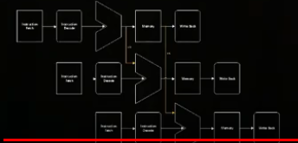
Forwarding
Can eliminate dependency and thus data hazard
Forward the data to another instruction (directly out of ALU, before reaching the WB stage) that needs it.

Slide 20
Branch in a pipeline
BEQ R1,R2,Label. Compare R1 and R2 if equal branch to label (change PC to branch location), else execute next instruction (just increment PC by 4 bytes as usual)
As next instructions are already fetched in the pipeline they will have to be either replaced in case of a branch or used in case the branch did not take place.

Slide 21
Control Hazards
Branches (changing PC value) are determined only two cycles (or more) after the branch instruction fetch.
A conditional statement needs to be evaluated, new memory location needs to be calculated then update the PC
Solutions: add nop, nop, nop after every brach
Other solutions involve move the branch hardware to stage 2 and add one nop.

Slide 22
Branch Prediction
Branch prediction is one of the solutions to Control Hazard
Static Predication or dynamic prediction.
Static Prediction
Predict that branches are always taken

